Slide 1
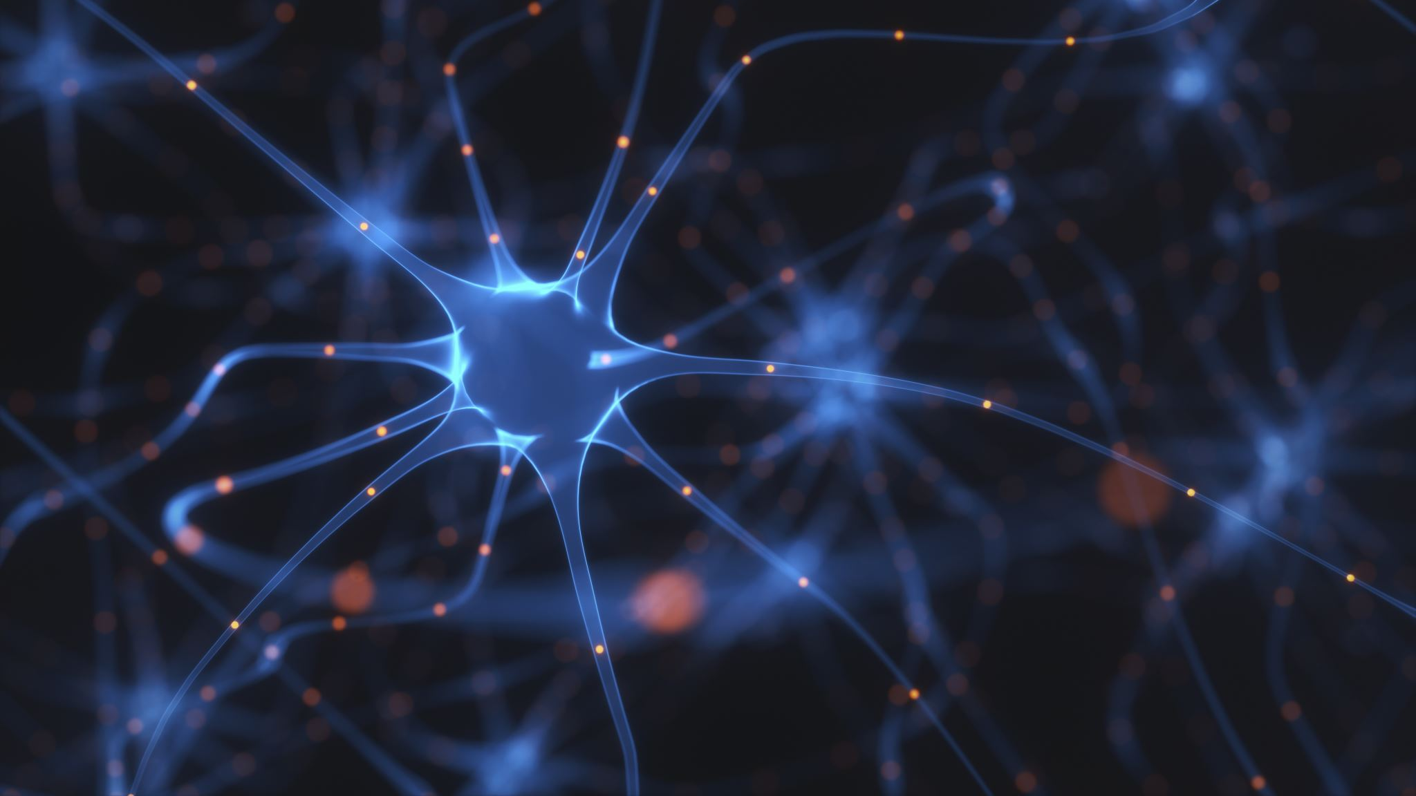
Convolutional Neural Network

Slide 2
CNN
A Convolutional Neural Network (CNN) is a type of Deep Learning neural network architecture commonly used in Computer Vision.
Computer vision is a field of Artificial Intelligence that enables a computer to understand and interpret the image or visual data.

Slide 3
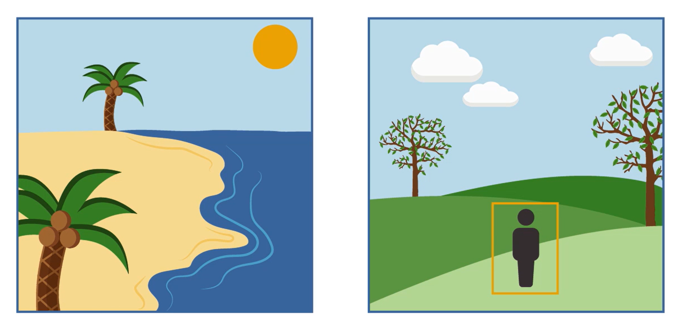
Object detection
Segmentation
Image processing

Slide 4
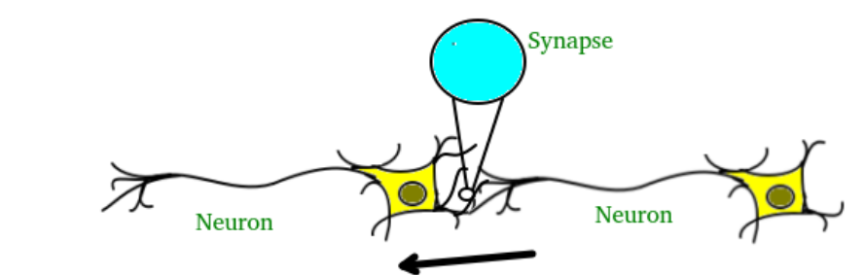
Neurons
The brain consists of hundreds of billions of cells called neurons.
These neurons are connected together by synapses which are nothing
but the connections across which a neuron can send an impulse to another neuron.

Slide 5
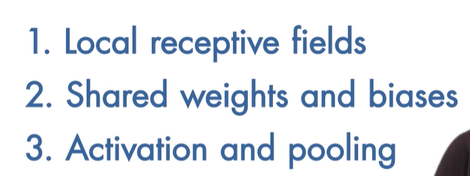
CNN steps for execution

Slide 6
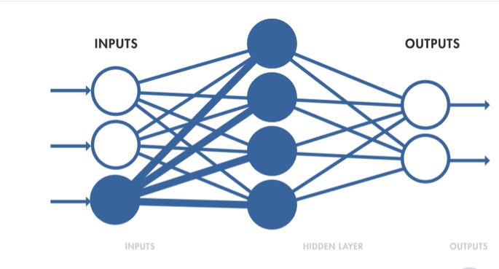
Typical neural network

Slide 7
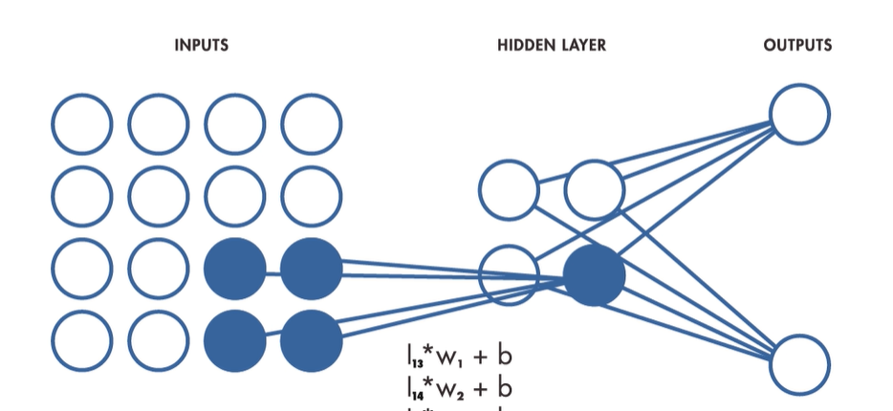
Convolutional neural network

Slide 8
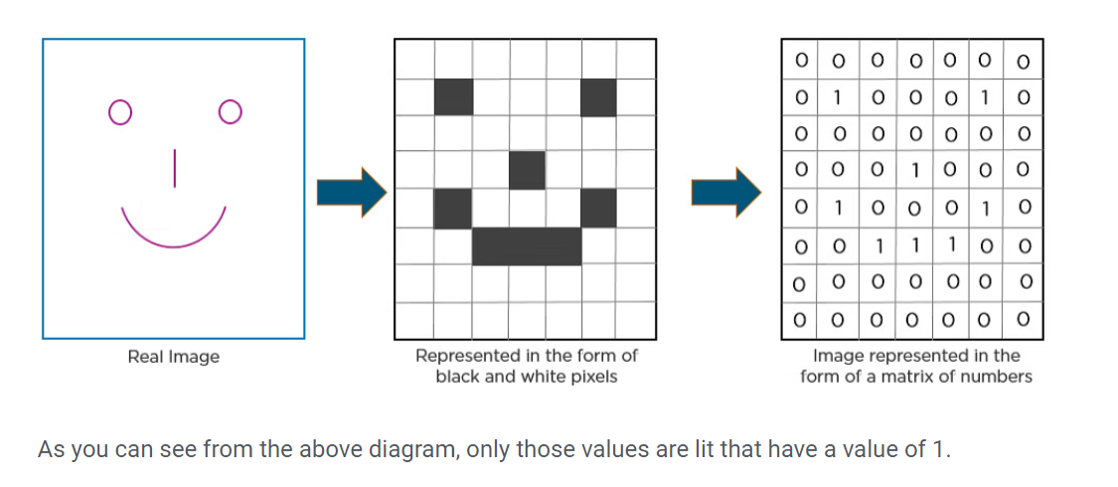
How CNN recognizes image

Slide 9
Layers in a Convolutional Neural Network
A convolution neural network has multiple hidden layers that help in extracting information from an image. The four important layers in CNN are:
Convolution layer
ReLU layer
Pooling layer
Fully connected layer

Slide 10
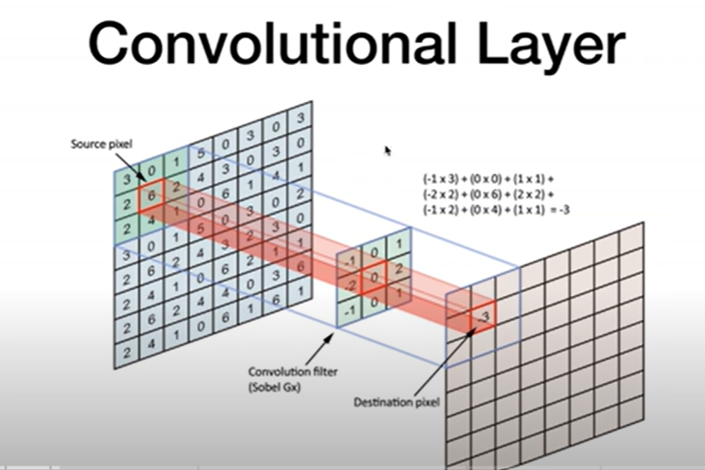

Slide 11
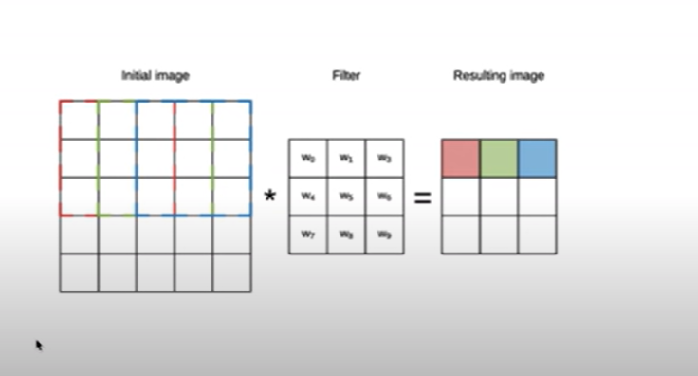
Sliding window filter

Slide 12

convolution

Slide 13
Convolution Layer
This is the first step in the process of extracting valuable features from an image. A convolution layer has several filters that perform the convolution operation.
Every image is considered as a matrix of pixel values.
Consider the following 5x5 image whose pixel values are either 0 or 1. There’s also a filter matrix with a dimension of 3x3.
Slide the filter matrix over the image and compute the dot product to get the convolved feature matrix.

Slide 14
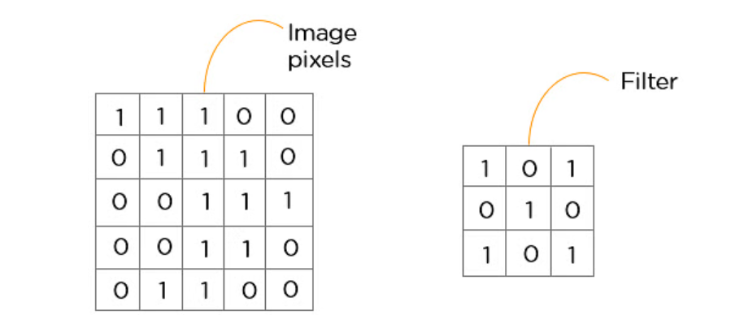

Slide 15
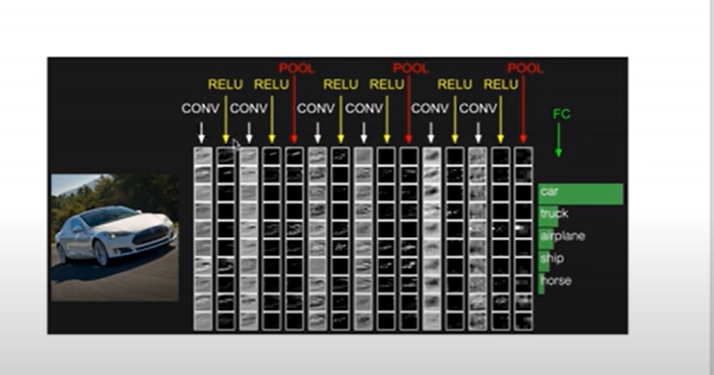

Slide 16
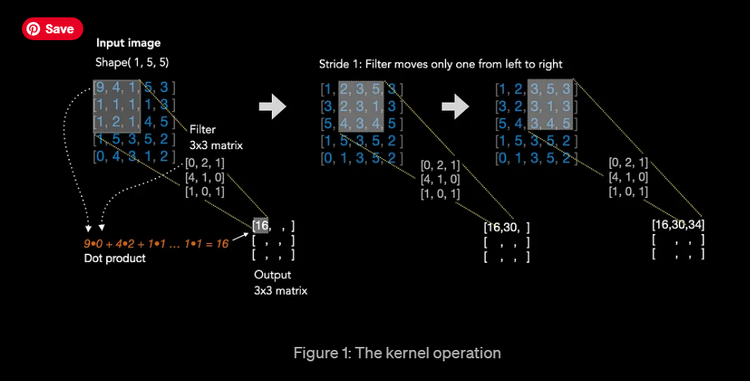
Kernel operation for grayscale images

Slide 17
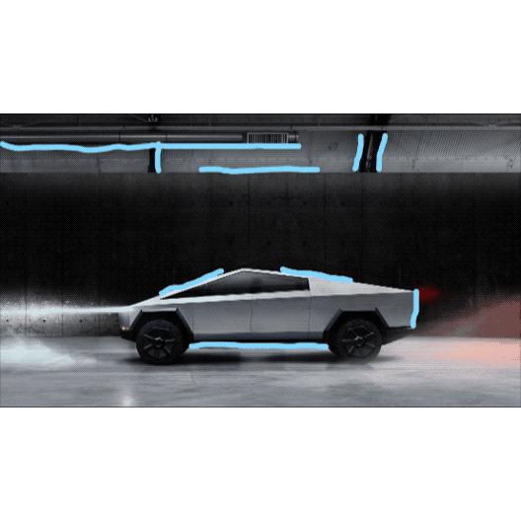
Vertical edge detection example

Slide 18
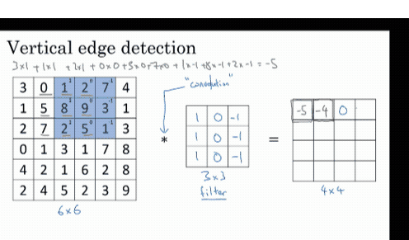
Convolve the image with a 3x3 filter

Slide 19
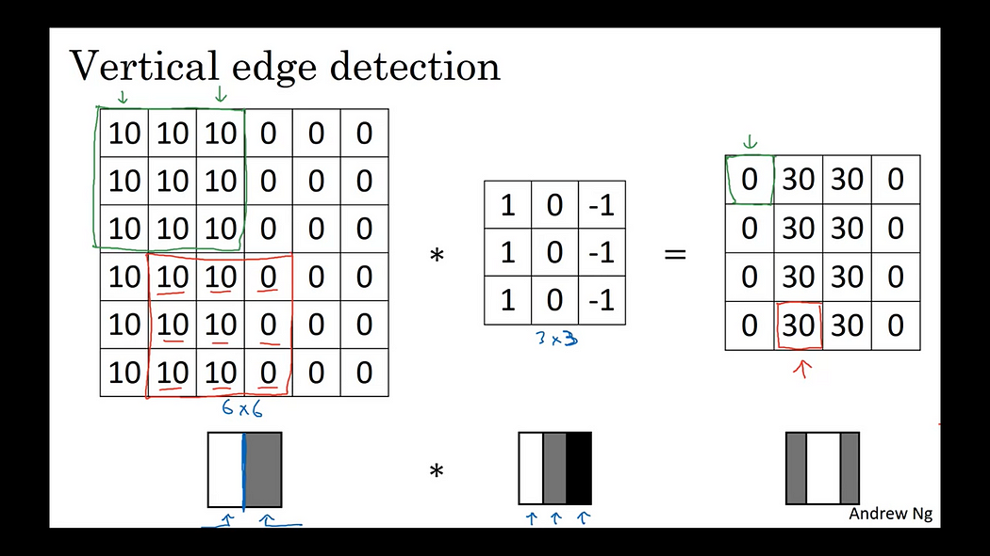
Output feature map

Slide 20
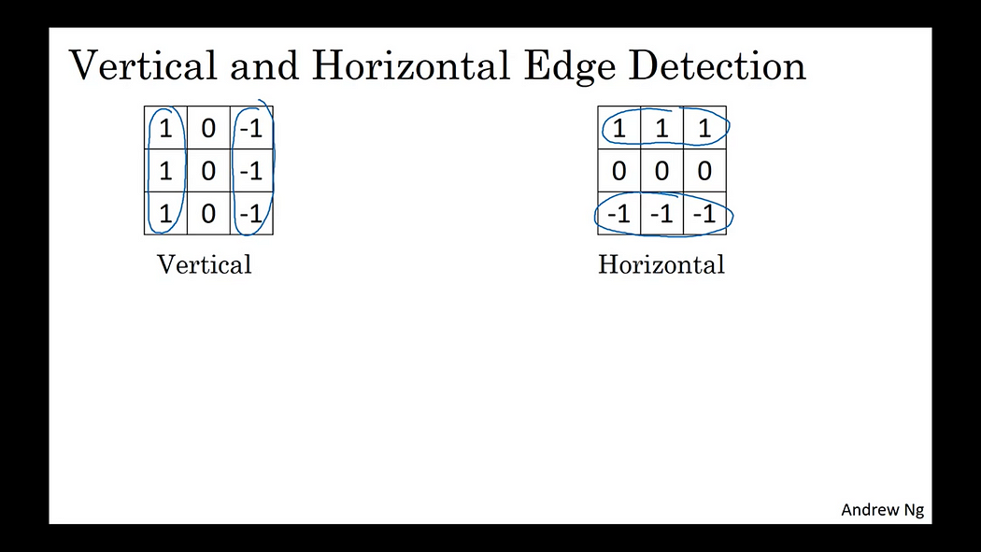
Vertical and horizontal edge detection

Slide 21

Activation functions in CNN

Slide 22
WHAT IS THE RELU ACTIVATION FUNCTION?
The rectified linear unit (ReLU) or rectifier activation function introduces the property of nonlinearity to a deep learning model and solves the vanishing gradients issue.
It interprets the positive part of its argument. It is one of the most popular activation functions in deep learning.

Slide 23
RELU
In simple terms, this can also be written as follows:
if input > 0:
return input
else:
return 0
All the negative values default to zero, and the maximum for the positive number is taken into consideration.

Slide 24
What is vanishing gradient problem?
Vanishing gradient problem is a phenomenon that occurs during the training of deep neural networks, where the gradients that are used to update the network become extremely small or "vanish" as they are backpropogated from the output layers to the earlier layers.
During the training process of the neural network, the goal is to minimize a loss function by adjusting the weights of the network.
The backpropogation algorithm calculates these gradients by propogating the error from the output layer to the input layer.

Slide 25
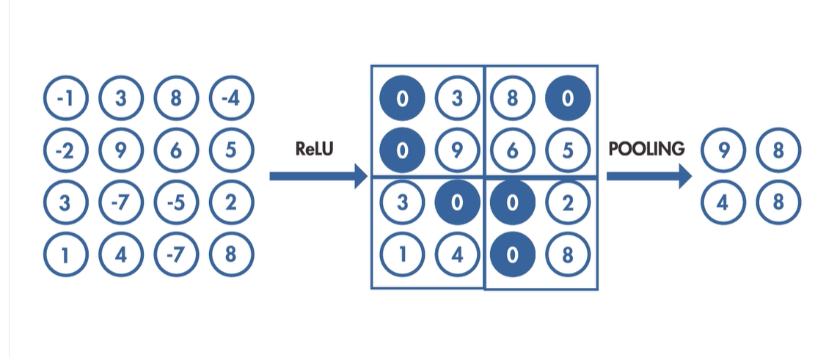
Activation function(feature selection) and pooling(dimension reduction)

Slide 26
When to apply activation functions
In a CNN, activation functions are typically applied after each convolutional layer and fully connected layer.
However, they are not applied after pooling layers.
The purpose of using activation functions after the convolutional and fully connected layers is to introduce non-linearity into the model after performing linear operations (convolution and matrix multiplication).
In essence, activation functions serve as the “switch” in artificial neurons that decide whether that neuron should be activated or not based on the weighted sum of the input.

Slide 27
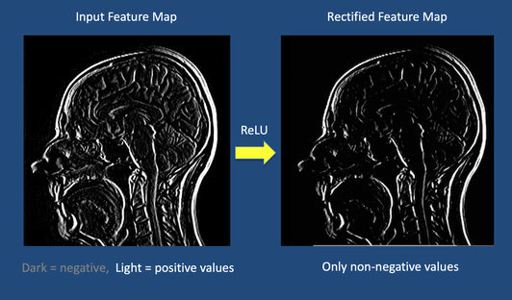
WHAT IS THE RELU ACTIVATION FUNCTION?
An activation function is also commonly applied during feature map generation to constrain output pixels to a certain range.
a common choice is the Rectified Linear Unit (ReLU) function that passes through only positive values to the feature map and sets all negative pixels to zero.

Slide 28

RELU
In simple terms, this can also be written as follows:
if input > 0:
return input
else:
return 0

Slide 29
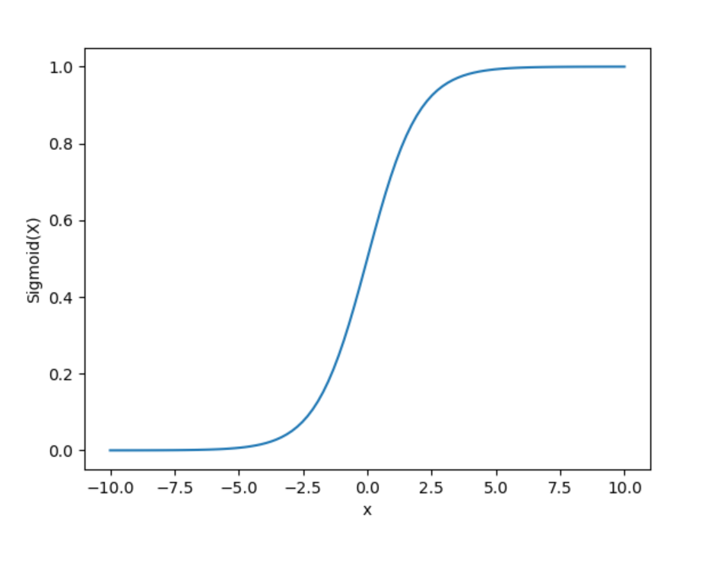
Sigmoid Function
It is a function which is plotted as ‘S’ shaped graph.
Equation : A = 1/(1 + e^{-x})
Nature : Non-linear. Notice that X values lies between -2 to 2, Y values are very steep. This means, small changes in x would also bring about large changes in the value of Y.
Value Range : 0 to 1
Uses : Usually used in output layer of a binary classification,
where result is either 0 or 1, as value for sigmoid function lies between 0 and 1 only so,
result can be predicted easily to be 1 if value is greater than 0.5 and 0 otherwise.

Slide 30
Softmax Function
The softmax function is also a type of sigmoid function but is handy when we are trying to handle multi- class classification problems.
Nature :- non-linear
Uses :- Usually used when trying to handle multiple classes. the softmax function was commonly found in the output layer of image classification problems.
The softmax function would squeeze the outputs for each class between 0 and 1 and would also divide by the sum of the outputs.
Output:- The softmax function is ideally used in the output layer of the classifier where we are actually trying to attain the probabilities to define the class of each input.

Slide 31
Pooling (Downsampling)
​The next step, pooling, shrinks the size of each feature map by 75% or more.
This allows only the most important features to be retained, thus reducing the number of learnable features of the model. With fewer parameters, pooling helps prevent overfitting of data.

Slide 32
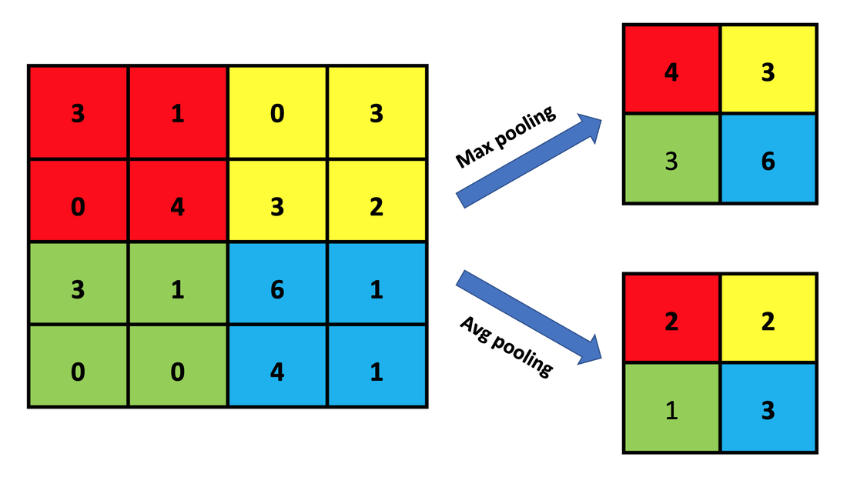

Slide 33
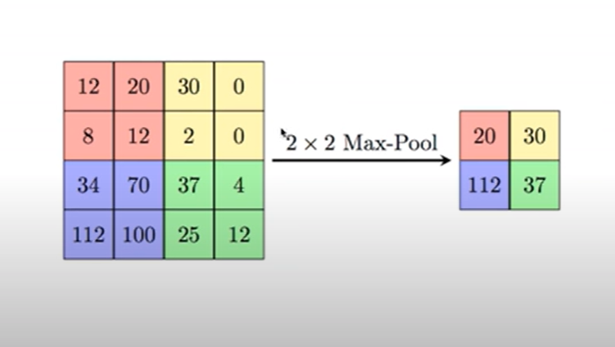
Maxpooling is used to reduce computational cost
Reduces number of parameters
2x2 filter is used
The image is divided into 2x2 square regions
Max number from this region is written to output image
Reduces overfitting

Slide 34
Activation function(feature selection) and pooling(dimension reduction)

Slide 35
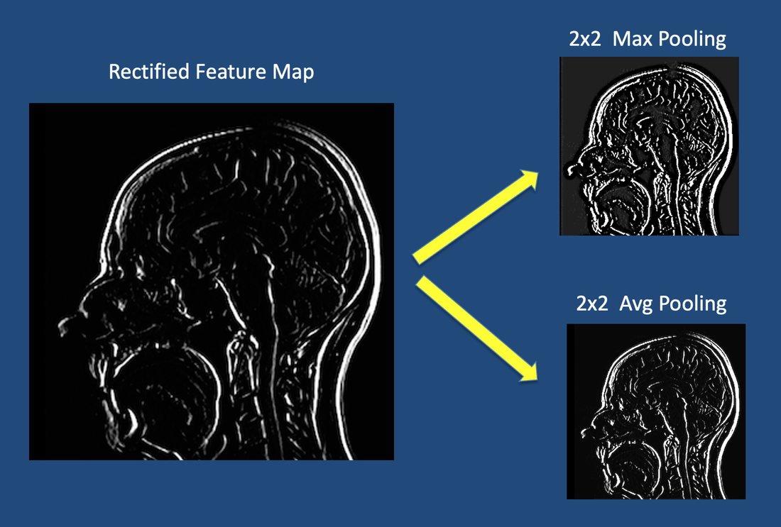

Slide 36
Convolution, Activation, and Pooling ..... Repeat
The convolution-pooling process may be repeated several times, producing ever smaller "feature of feature" maps.
Pooling is not always performed after each convolution; in some networks several convolutions are performed followed by a pooling step.

Slide 37
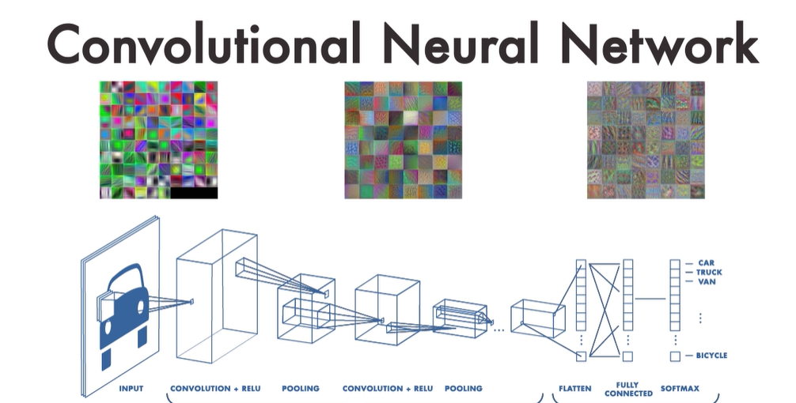

Slide 38
Final Processing Steps
Many possibilities exist once the multiple convolution-pooling process is complete.
One common final stage, known as vectorization or flattening,
converts the last 2-dimensional feature maps into a single long chain of numbers (i.e., a "vector").
The vectorized feature maps then serve as inputs into a fully connected neural network whose output can be used to produce a final "decision" (such as tissue segmentation or disease classification).

Slide 39
Flattening
The next step in the process is called flattening.
Flattening is used to convert all the resultant 2-Dimensional arrays from pooled feature maps into a single long continuous linear vector.

Slide 40
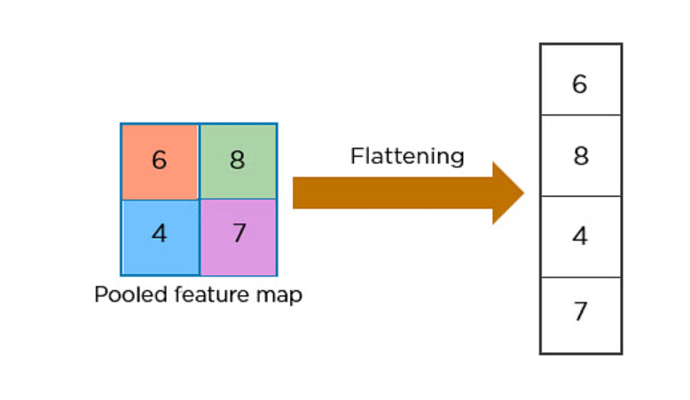

Slide 41
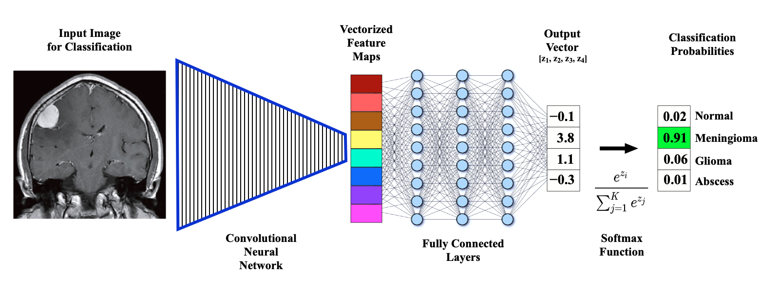

Slide 42
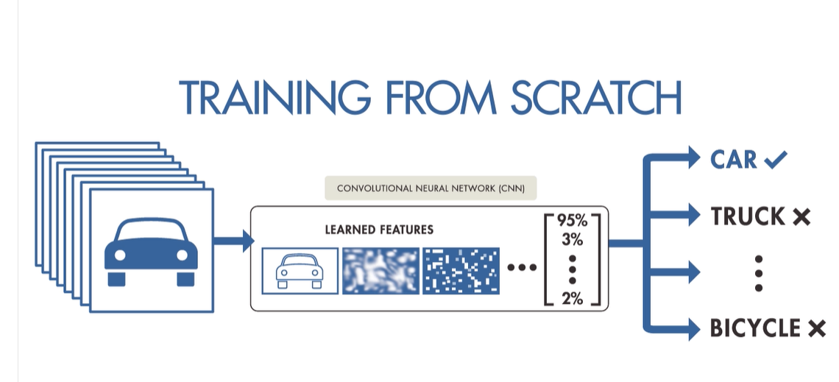
Training from scratch

Slide 43
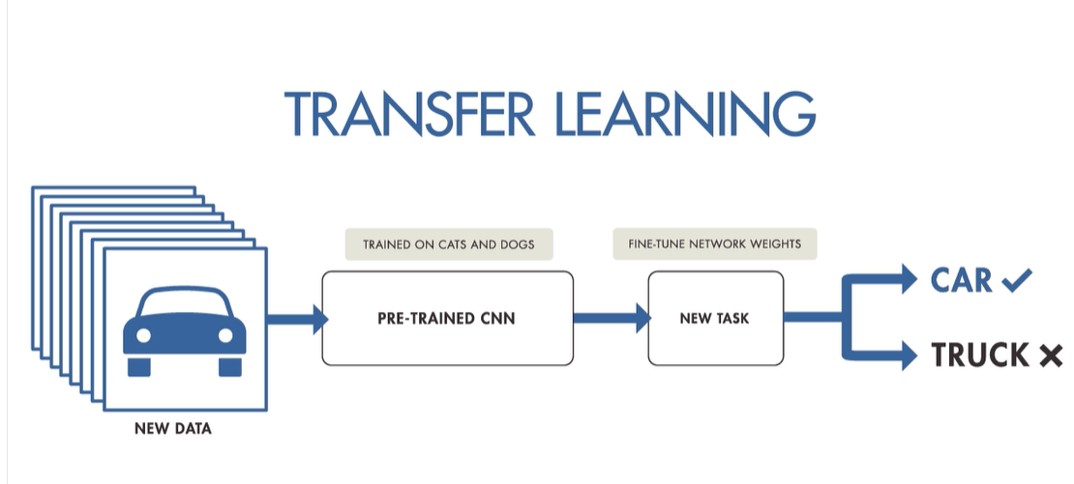
Transfer learning

Slide 44
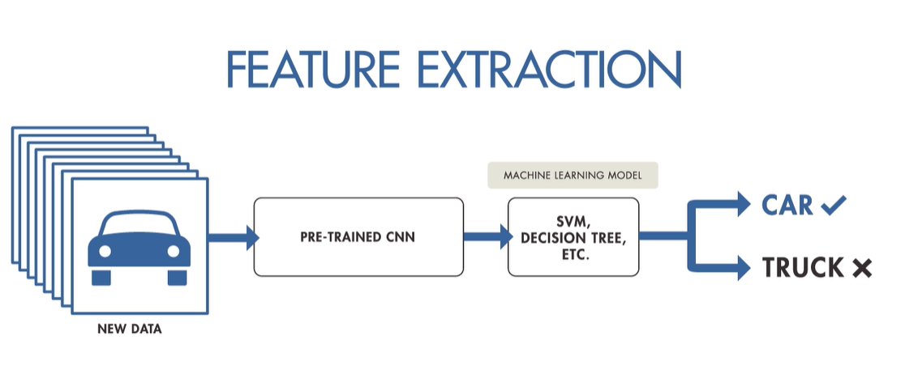

Slide 45
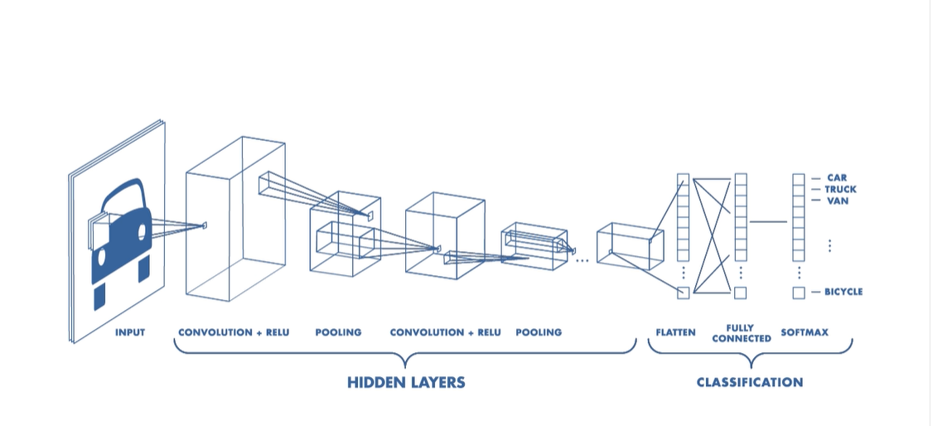
CNN

Slide 47
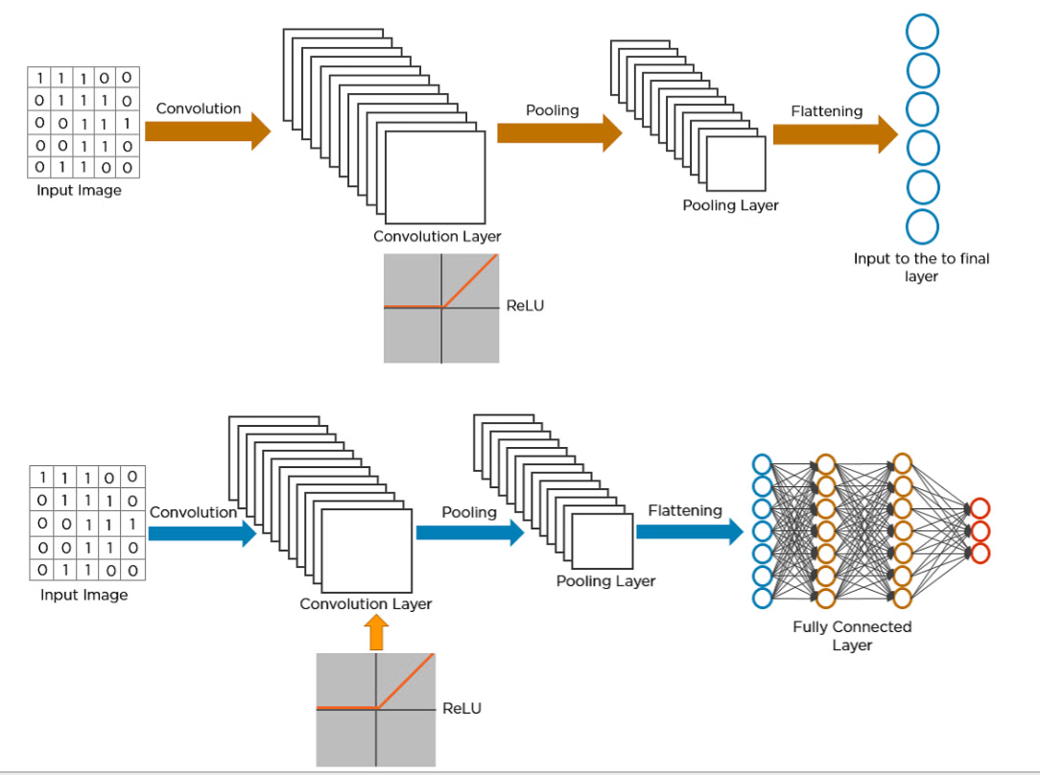

Slide 48
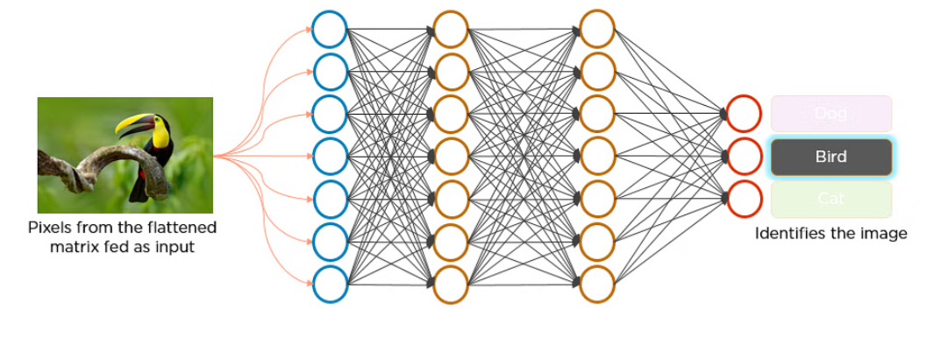

Slide 49
Maxpooling is used to reduce computational cost
Reduces number of parameters
2x2 filter is used
The image is divided into 2x2 square regions
Max number from this region is written to output image
Reduces overfitting

Slide 50
Data Augmentation
Having a large dataset is crucial for the performance of the deep learning model.
However, we can improve the performance of the model by augmenting the data we already have.
It also helps the model to generalize on different types of images.
In data augmentation, we add different filters or slightly change the images we already have for example add a random zoom in, zoom out, rotate the image by a random angle, blur the image, etc.

Slide 51
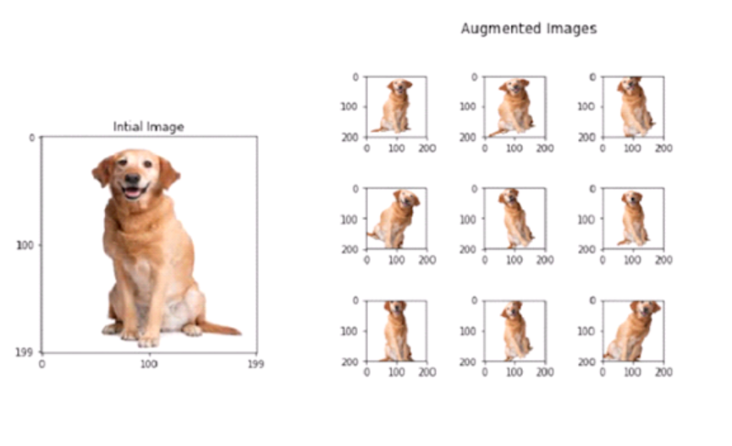

Slide 52
Handling Overfitting and Underfitting problem
What is overfitting?
Overfitting happens when a model learns the detail and noise in the training data to the extent that it negatively impacts the performance of the model on new data.
In another word an overfitted model performs well on the training set but poorly on the test set, this means that the model can’t seem to generalize when it comes to new data

Slide 53
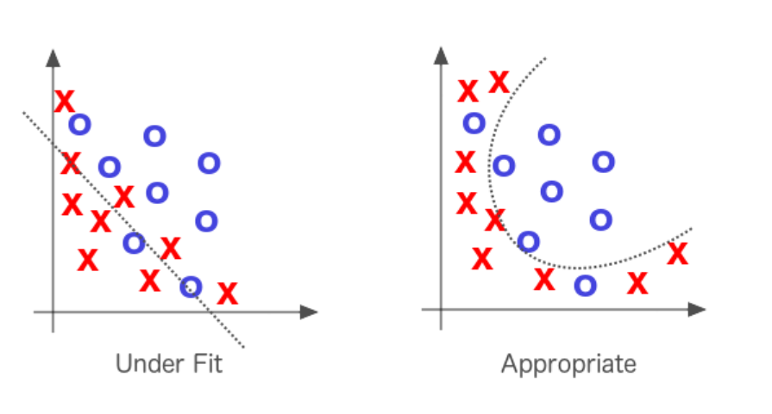
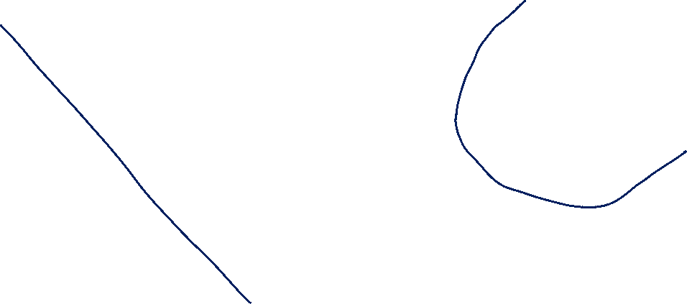

Slide 54
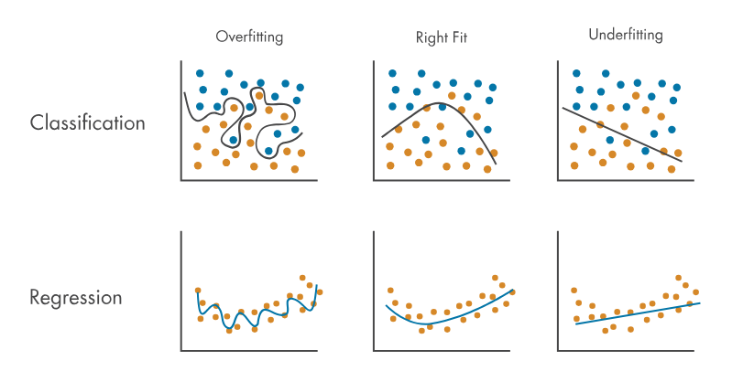


Slide 55
Under-fitting
Underfitting is the opposite scenario where the model does not learn enough from the training data
that it does poorly on both training and test dataset.
This usually happens when there is not enough data to train on.

Slide 56
Methods to overcome Over-fitting:
There a couple of ways to overcome over-fitting:
1) Use more training data
This is the simplest way to overcome over-fitting
2 ) Use Data Augmentation

